Slide 1
Game Scene Milestone
CHLOE WOODMAN

Slide 2
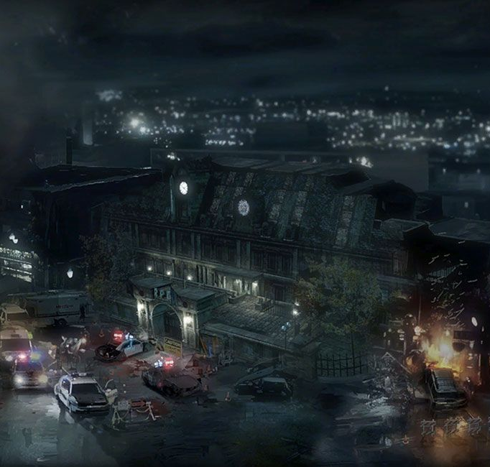
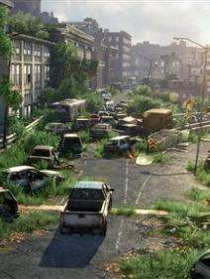
Dystopian Topic
My game scene will be based on the theme idea of a dystopian city. I have decided to base it on a city that was once chaos and has been abandoned from humanity, with traces of nature reclaimant. My inspiration is Racoon city for Resident Evil and scenery from The Last of Us.
Figure 2

Slide 3
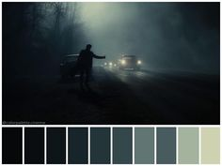
Theme color pallet
These are the colours I will be using for my scene. Due to the cool tones and dark hues in the color, with little saturation, I believe it can set a nice tonal impression and play on the fact that the city is dystopian and abandoned.

Slide 4


What scene will have
Billboards
Skybox/sky dome and fog
Most likely using clouds and random plants and ivy as an implementation
Will have a skybox or sky dome, maybe using a moody sky, and fog to compliment the horizon
Terrain and interactive building models
Mini map
Model will be that of abandoned buildings and maybe cars, Colliders will be present to make these buildings and cars interactive
You will have a mini map illustrate where you are in the scene for easier navigation

Slide 5
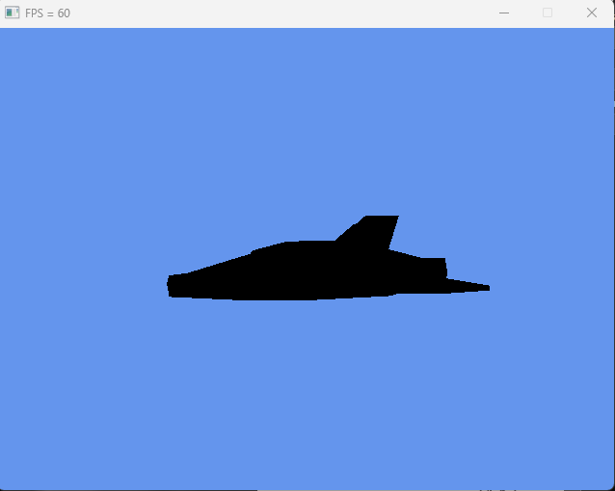
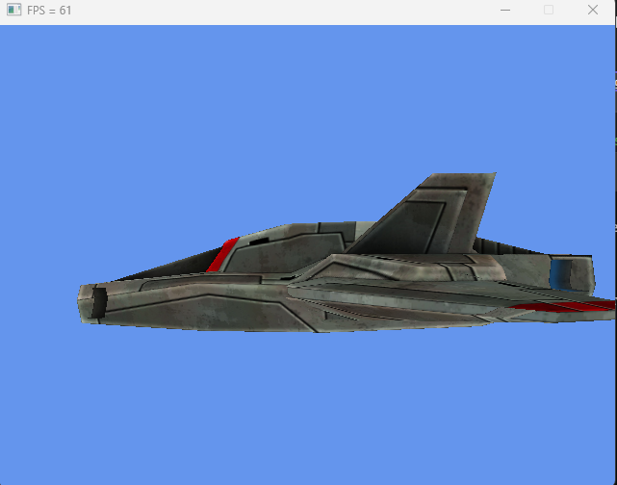
My scene so far has a renderer for models with textures with a broken skybox and rotating camera. I need to fix my skybox code to work next; also, I have imported some models and textures for my scene in preparation, though I have not tested them yet.
The scene is running at 60 frames per second which is good for game scenes because it holds a lot of motion and allows for smooth movements for scenes. It is also the standard, so many cheaper monitors have a highest run time of 60 fps. For more information about performance please go to the README. on GitHub as I go in deep detail.

Slide 6
Bibliography
Figure 1 – https://www.deviantart.com/viictorfreiitaz/art/Operation-Raccoon-City-204423057
Figure 2 – https://phys.org/news/2013-06-beautiful-wasteland.html
Figure 3 - https://www.pinterest.co.uk/hailey713/colors/

